Slide 1
Data science, urban trees and wellbeing
Peter Edwards, Seanglidet Yean, Lee Bu Sung Francis, Gradon Diprose, Robyn Simcock, Jan Schindler, Richard Green

Slide 2
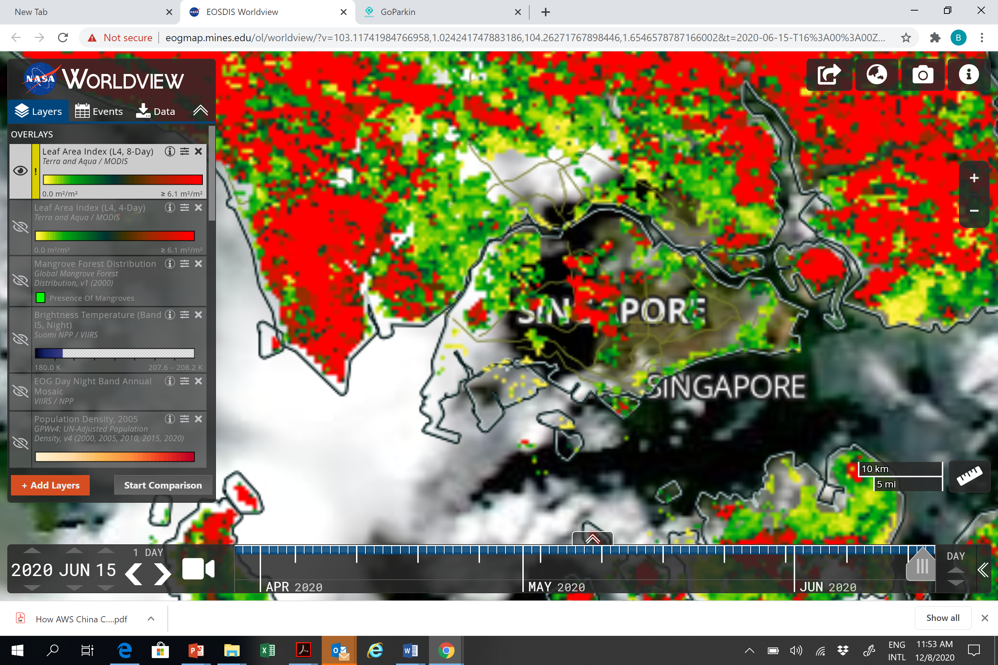
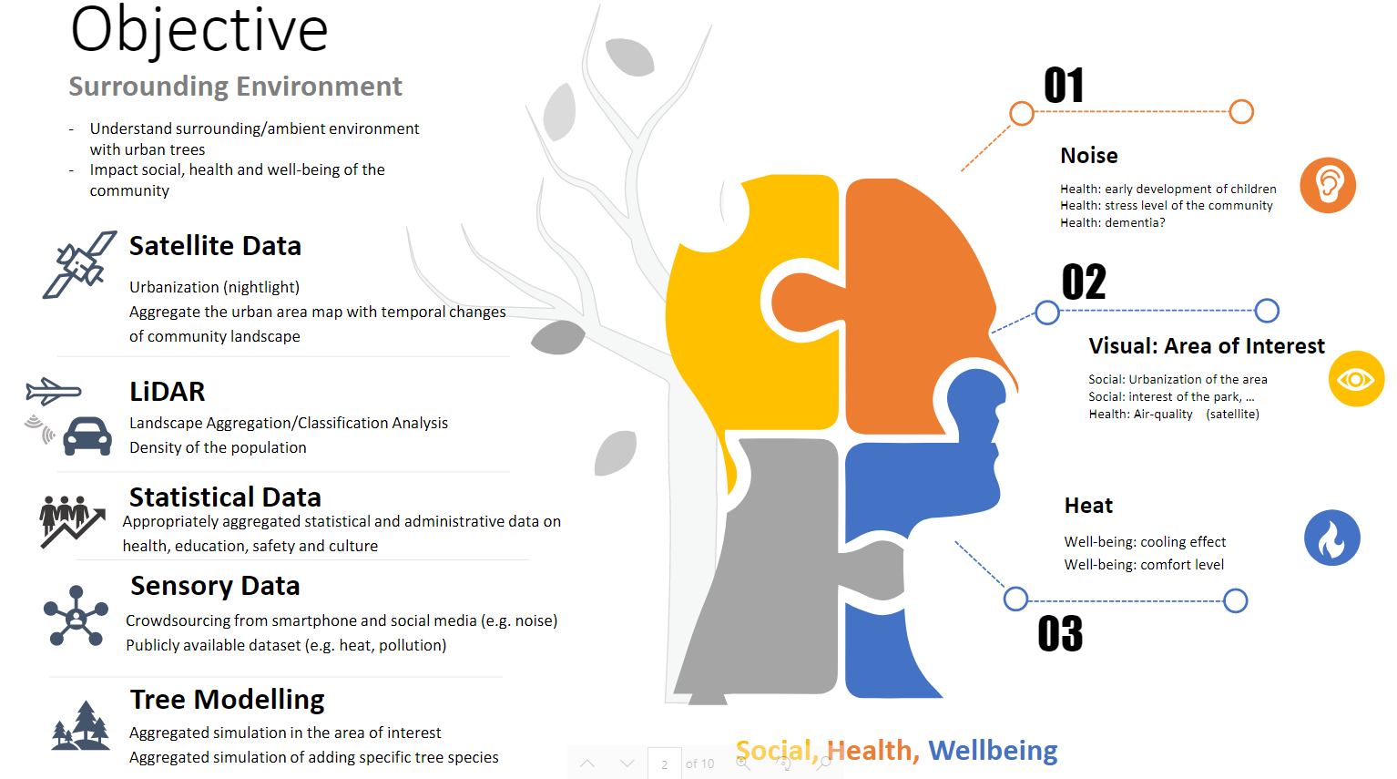
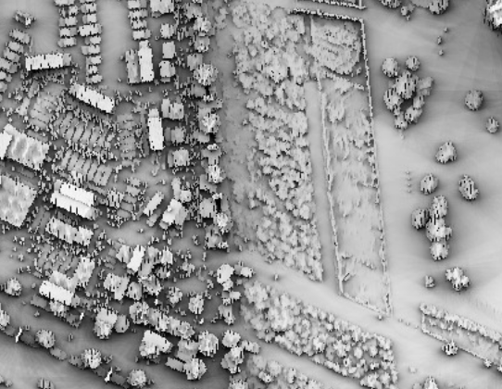
Remotely sensed data:
LiDAR
Satellite data
Administrative data:
General health
Crime
Deprivation
Educational attainment
Cultural indicators
Sensory data
Notes:
Epidemiological methods to bring together remote sensing data and quantitative data on social wellbeing indicators through a ‘sensory’ approach to determine correlations between urban trees and human wellbeing

Slide 3
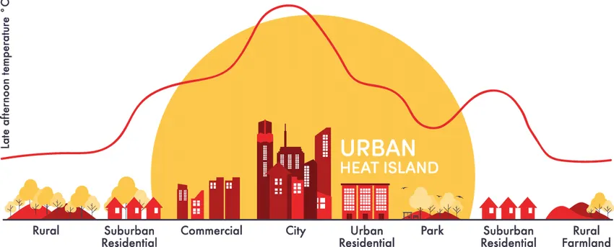
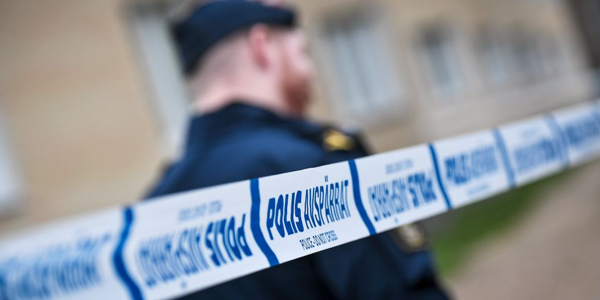
Wellbeing?
Measures of how people feel about their lives:
Life satisfaction
Health
Housing
Human rights
Finances
Safety & security
Cultural identity
Educational attainment

Slide 4
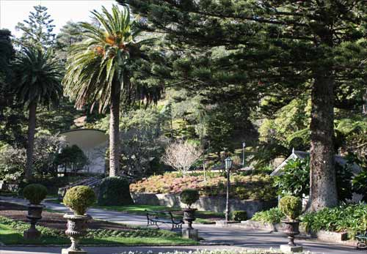
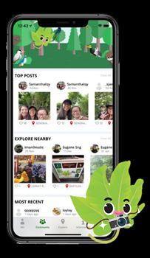
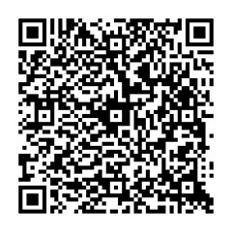
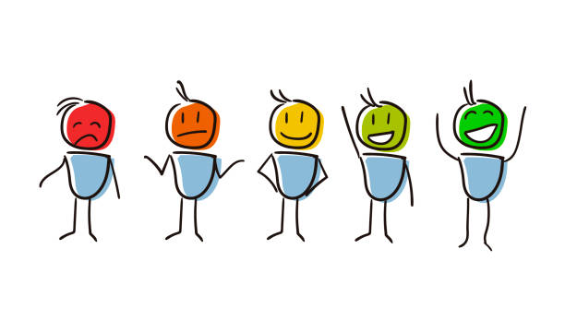

Slide 5
Contacts
New Zealand contact:
Peter Edwards – EdwardsP@landcareresearch.co.nz
Singapore contact:
Seanglidet Yean – seanglidet.yean@ntu.edu.sg

